Slide 1
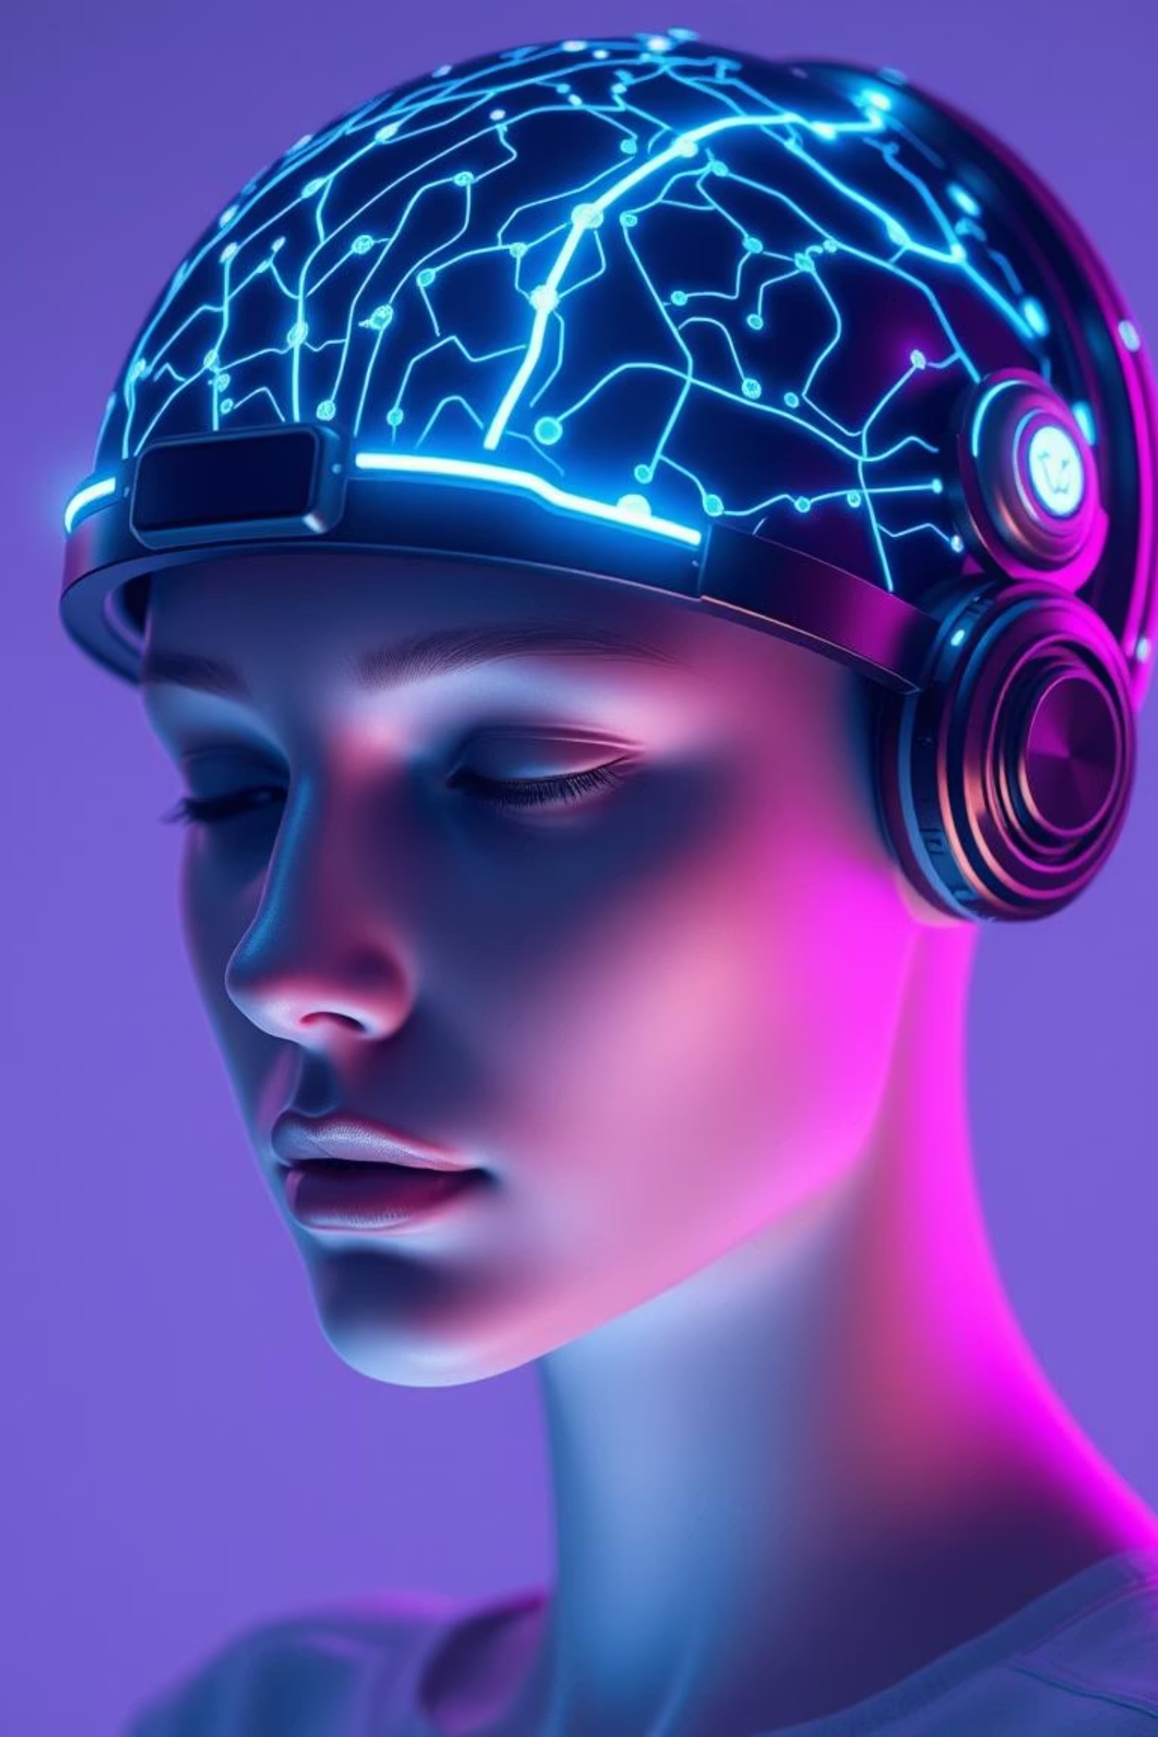

VAANI – Brain Computer Interface (BCI)
Theme –
Building for Bharat with the Power of GenAI
Sub Theme –
Assistive Neuro-AI For Bharat
Presented by Bellapukonda Pooja, Dayananda Sagar Academy of Technology and Management, CSE-AI
When the Body Fails, Let the Mind Speak…

Slide 2

Problem Statement
Arya, 18, has ALS. Her mind is sharp, but her body is silent.
She uses an eye-tracking device costing ₹3.5 lakhs - yet it takes her 4 minutes just to say, “I’m in pain.”
Over 2.5 million Indians face similar struggles due to ALS, locked-in syndrome, or paralysis.
72% of caregivers report that current tools fail during emergencies.
Most solutions are costly, slow, and not built for Indian languages or voices.
We’re building a compassionate AI companion - one that speaks your mind, literally. By translating brain (EEG) signals into speech in the user’s own voice and language. Our Assistive Neuro-AI restores not just communication, but dignity, connection, and hope. This is more than a tool. It’s a voice for the voiceless. It’s Vaani - for Bharat.

Slide 3




Vaani: A New Voice for the Voiceless
Brainwave Capture
Intent Decoding
A headset captures raw EEG signals, extracting 128 unique features that represent user intent.
These features are rapidly decoded to determine core intent words, such as "pain" or "water."
Sentence Generation
Voice Restoration
A Generative AI model transforms these keywords into a natural, grammatically correct sentence.
A voice cloning module synthesizes the sentence in the user's own personalized voice.
Unlike traditional eye-tracking devices that are agonizingly slow (8 seconds per letter), our system enables real-time, hands-free, voice-based communication, transforming lives.

Slide 4
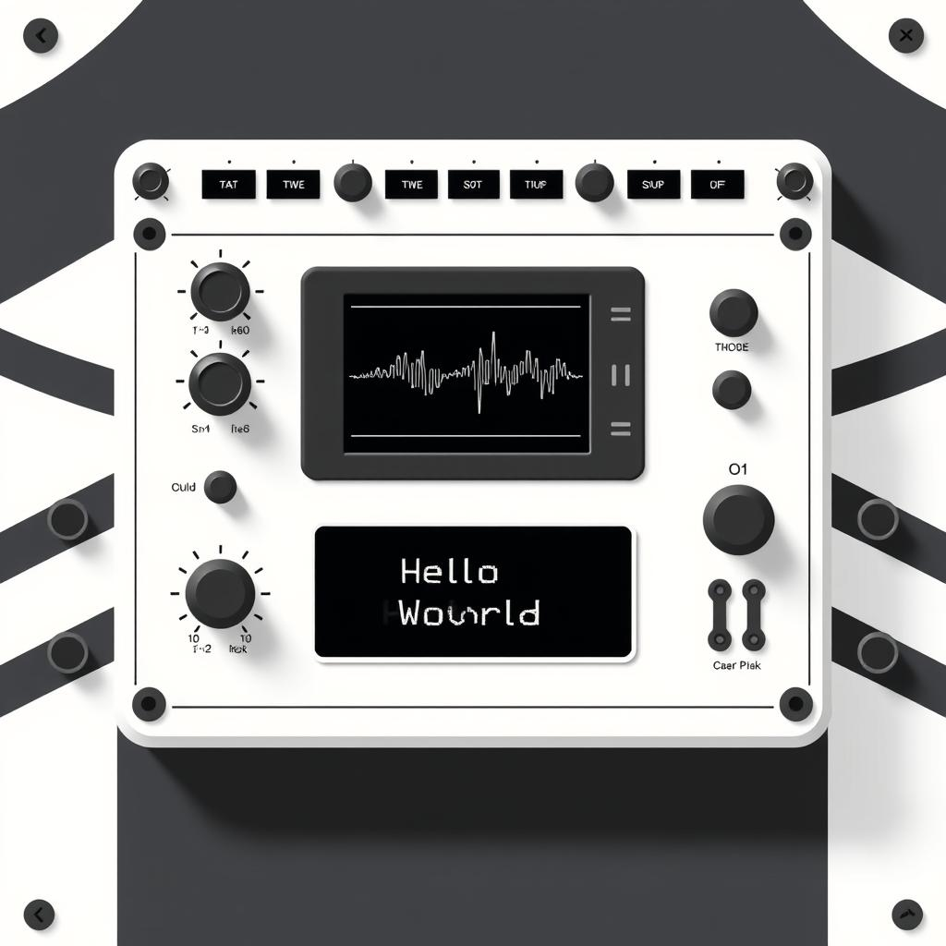
MVP Stack: Simulating the Future Today
For our Minimum Viable Product, we simulate EEG input using user-provided feature values, paving the way for future hardware integration.
Tech Stack Used
AI & APIs
Frontend: HTML5, CSS3, JavaScript
Generative AI: Hugging Face LLM API (keywords to sentences)
Backend: Python, Flask
ML Pipeline: Scikit-learn (SVM-based intent classifier)
Voice Cloning: Speechify API (custom voice TTS)
Fallback System: Hybrid model with predefined emergency phrases for TTS, ensuring resilience.

Slide 5




Why Vaani Works: Design & Decisions
Patient-Specific Model
Fast & Scalable
Resilient Fallback
EEG signals are unique to each individual. Vaani trains separately for each patient, ensuring maximum accuracy and practical feasibility.
Once trained, the system only requires real-time EEG features, enabling seamless, instantaneous speech generation without delay.
Even in offline or low-spec environments, Vaani’s predefined phrase mode provides uninterrupted critical communication.
Key Assumptions:
Patient has completed initial system training with their personal data.
User/device remains in a stable position during EEG signal collection.

Slide 6
Real-World Impact: Vaani vs. Eye-Tracking
Comparison with Eye-Tracking Devices
Impact Metrics: Measuring Success
Speed
8 sec/letter
Real-time
90%
Reduction in communication time
Cost
₹3.5 Lakhs
Scalable
95%
Voice
Robotic
Personalized
Accuracy of intent detection
Usability
Needs stable eyes
Works hands-free
90%
Increase in user satisfaction
95%
100%
Intent Prediction Accuracy
Personalized Empathy
Accuracy significantly increases with
patient-specific training sessions.
Custom-trained models enhance not just accuracy,
but also the emotional connection.

Slide 7

Scalability & Future Horizons
Built for Bharat, Scalable for the World
Future Use Cases
Smart home control: Empowering paralyzed users with voice commands.
Seamlessly functions in diverse regional languages of India.
Neuro-surveillance: Innovative applications in high-security environments, based on brain signals.
Voice personalization fosters emotional connection and familiarity.
Accessibility in Education: Enabling students with communication challenges to participate fully.
A low-cost, flexible solution ideal for widespread adoption in homes, schools, and clinics.

Slide 8

Methodology & Architecture: The Vaani Blueprint
Our compassionate BCI-based AI companion decodes EEG signals into speech using GenAI and voice cloning. We extract key intent words from EEG patterns, leveraging language models to generate complete, personalized sentences.
Core Principles:
Key Components:
Neuro-Signal Interpretation: Decoding EEG patterns.
EEG Signal Input: (User input for MVP)
Intent Recognition: Utilizing ML models.
Feature Decoder: Extracts 128 top EEG features.
Sentence Formation: Via GenAI.
ML Classifier: Predicts intent words.
Voice Restoration: With cloned voice (TTS).
GenAI API: (Hugging Face) for sentence generation.
Speechify API: For voice cloning.
Hybrid Mode: Pre-defined messages fallback for resilience.

Slide 9
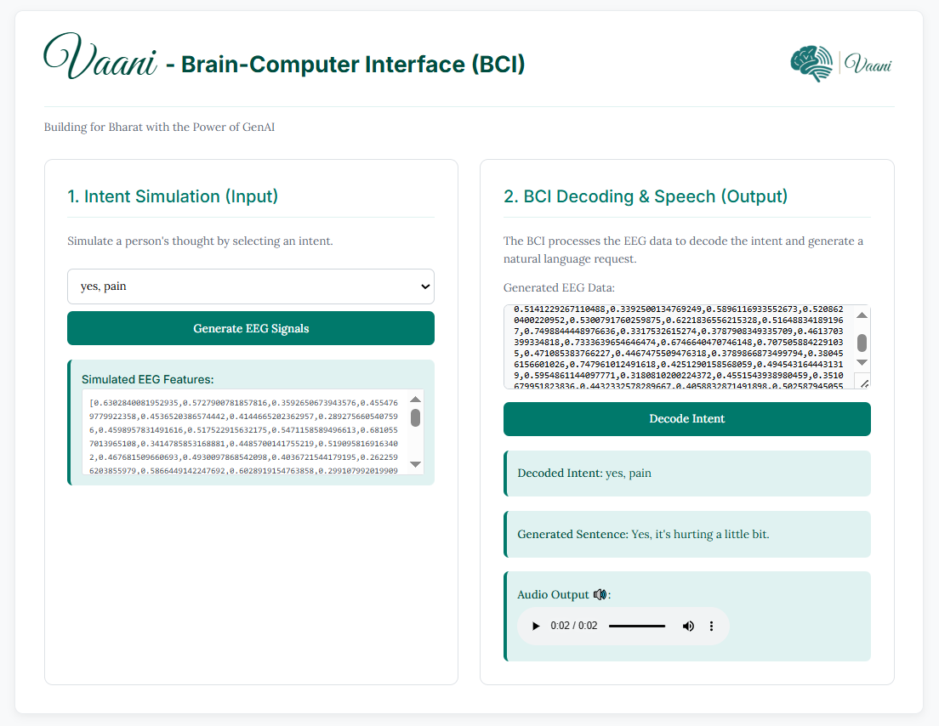
Visualization & Analysis: Vaani in Action
See how Vaani translates complex brain signals into clear, concise speech, empowering users with a voice of their own.
Wireframes
Vaani drastically reduces communication
time from minutes to seconds.

Slide 10

Thank You

